Slide 1

Hello…We are 5LE PACT…
If you have any questions regarding the PACT Service, please do not hesitate to contact any member of the team for more information!
PACT Care Coordinators
PACT Administrator
Kelly Robson
Kelly.Robson@bradford.nhs.uk
Denise Mitchell
Denise.Mitchell2@bradford.nhs.uk
Ashleigh Taylor
Ashleigh.Taylor@bradford.nhs.uk
PACT Physio
PACT Clinical Lead
Sarah Hardy
On Call GP for each Practice
PACT OT
Chloe Kinsella
PCN Network Manager
Ayeesha Qureshi
Ayeesha.qureshi@bradford.nhs.uk

Slide 2




The PACT Offering
Are you aware of a patient suffering from unexplained falls? Trouble manoeuvring around their home due to their mobility?
Are they feeling lonely and isolated?
Are they coded as “moderate” Frailty and still independently living at home?
Would your patient benefit from a Proactive Full holistic Assessment, using the comprehensive geriatric assessment tool?
Our Service can offer support for:
Self Care
Financial Advice
Housing Advice
Safe and Sound Referral
Mental Health and Social Services Input
6CIT & Bloods
If so, refer to the 5 Lane Ends PACT Project via System1 or speak to our Care Coordinators Kelly Robson or
Ashleigh Taylor
PACT CARE COORDINATORS
For more information, or if you have any questions, please contact Ayeesha Qureshi, PCN Network Manager Ayeesha.Qureshi@bradford.nhs.uk

Slide 3
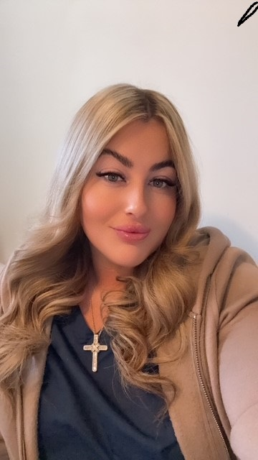
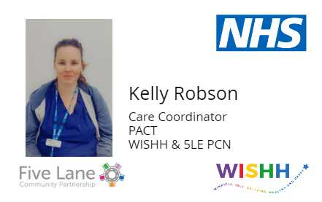
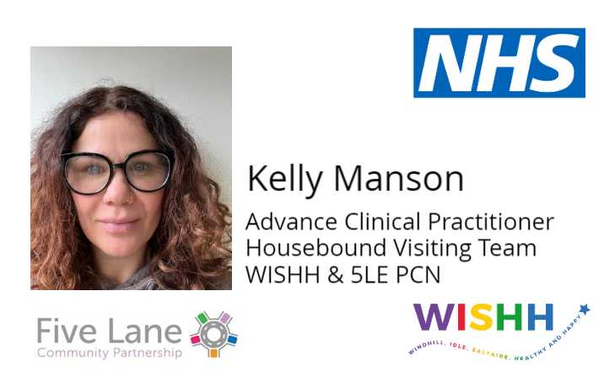
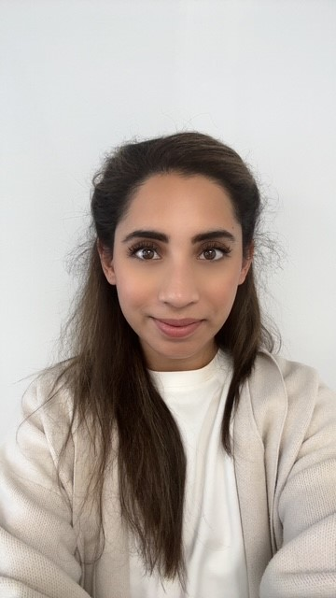
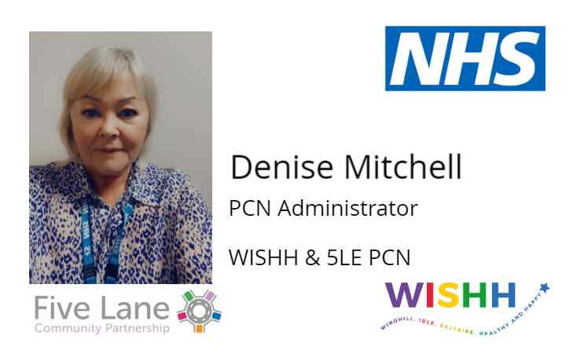
PACT Care Coordinators
5LE PACT & HBVT
Who Are We?
If you have any questions regarding the PACT Service, please do not hesitate to contact any member of the team for more information!
Ashleigh Taylor
Kelly Robson
Housebound Visiting Team
HR Team
Kelly Manson
Ayeesha Qureshi
Denise Mitchell

